Slide 1
Class Schedule
OPTIMIZATION
Group 15:
Pham Tuan Kiet 20214909
Hoang Minh Hoang 20214900
Le Trung Kien 20214907
Dang Kieu Trinh 20214933
INVESTMENTS

Slide 2
Table of contents
02. Greedy Algorithm
03. Local Search
01. Problem Introduction
05. Genetic Algorithm
06. Result Analysis
04. CP + MIP
Problem description
An naïve approach to the problem
Constraint Programming Mixed-Integer Programming
You can describe the topic of the section here

Slide 3
01
Problem Introduction

Slide 4
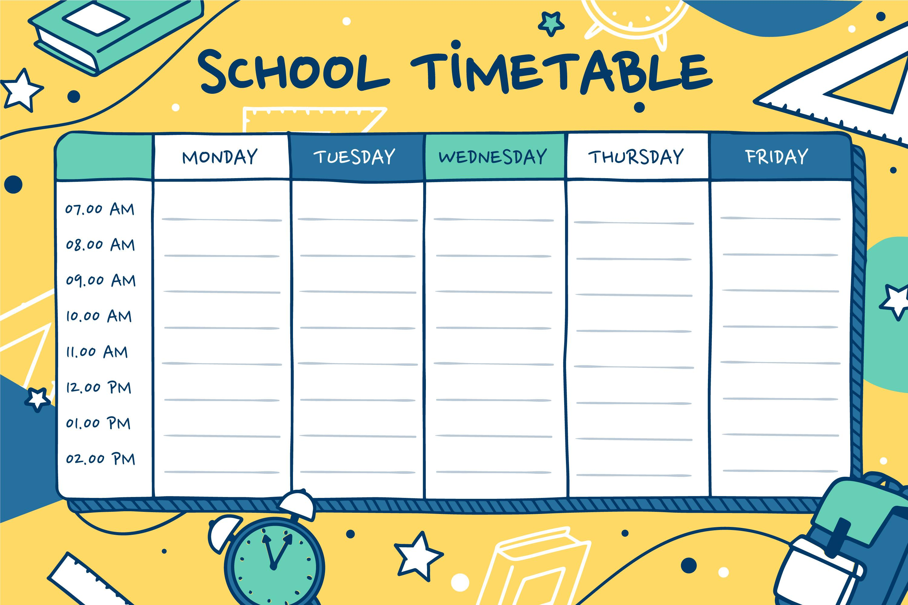
Arranging Timetable
There are N classes 1, 2, …, N that need to be scheduled. Each class i have: t[i] is the number of lessons, g[i] is the teacher teaching class i and s[i] is the number of students of class i.
There are M rooms 1, 2, …, M and c[i] is the number of seats in the room i.
In a week, there are 5 days (from Monday to Friday), each day is divided into 12 shifts (6 morning shifts and 6 afternoon shifts).
Create a schedule (assign day, shift and room to each class) that satisfies:
Two class having the same teacher need to be scheduled separately.
The number of students in each class has to be smaller than the capacity of the room.
The numbers of classes scheduled is maximized
Input:
+ The first line: N and M.
+ The next N line, each line write: t(i), g(i) and s(i).
+ The next line: c(1), c(2), …, c(n).
Output: Timetable

Slide 5
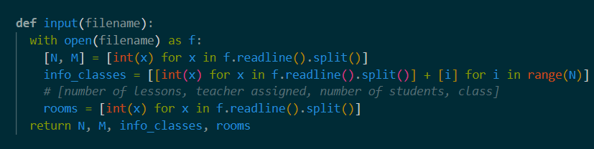
Arranging Timetable
N: The number of classes
M: The number of rooms
t[i]: The number of shifts in class i
g[i]: The teacher teaching class i
s[i]: The number of students in class i
c[r]: The capacity of room r

Slide 6
02
Greedy Algorithm

Slide 7
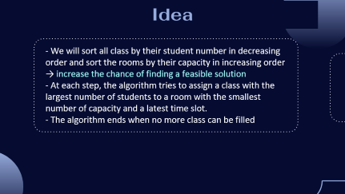
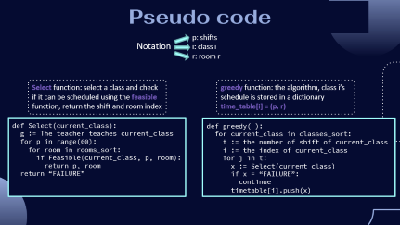
02. Greedy Algorithm
Idea
Pseudo code

Slide 8
Idea
- We will sort all class by their student number in decreasing order and sort the rooms by their capacity in increasing order
→ increase the chance of finding a feasible solution
- At each step, the algorithm tries to assign a class with the largest number of students to a room with the smallest number of capacity and a latest time slot.
- The algorithm ends when no more class can be filled

Slide 9
Pseudo code
p: shifts
Notation
i: class i
r: room r
Select function: select a class and check if it can be scheduled using the feasible function, return the shift and room index
greedy function: the algorithm, class i’s schedule is stored in a dictionary time_table[i] = (p, r)
def Select(current_class):
g := The teacher teaches current_class
for p in range(60):
for room in rooms_sort:
if Feasible(current_class, p, room):
return p, room
return “FAILURE”
def greedy( ):
for current_class in classes_sort:
t := the number of shift of current_class
i := the index of current_class
for j in t:
x := Select(current_class)
if x = “FAILURE”:
continue
timetable[i].push(x)

Slide 10
03
CP + MIP using Ortools

Slide 11
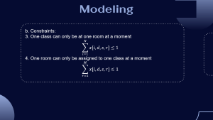
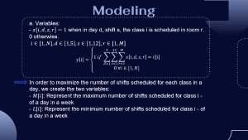
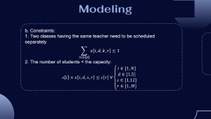
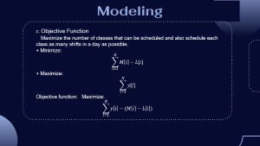
Modeling
a.Variables
c.Objectives
b.Constraints

Slide 12


Modeling
a. Variables:
- $x\left[i,d,s,r\right]=1$ when in day d, shift s, the class i is scheduled in room r. 0 otherwise.
$i∈\left[1,N\right], d∈\left[1,5\right], s∈\left[1,12\right], r∈[1,M]$
$$y\left[i\right]=\left\{\begin{aligned}1 if \sum_{d=1}^{5}{\sum_{s=1}^{12}{\sum_{r=1}^{M}{x\left[i,d,s,r\right]=t[i]}}} \\ 0 ∀i∈[1,N]\end{aligned}\right.$$
In order to maximize the number of shifts scheduled for each class in a day, we create the two variables:
- $M[i]$: Represent the maximum number of shifts scheduled for class i - of a day in a week
- $L[i]$: Represent the minimum number of shifts scheduled for class i - of a day in a week

Slide 13

Modeling
b. Constraints:
1. Two classes having the same teacher need to be scheduled separately
$$\sum_{i∈G[p]}{x\left[i,d,k,r\right]≤1}$$
2. The number of students < the capacity:
$$s\left[i\right]×x\left[i,d,s,r\right]≤c\left[r\right] ∀\left\{\begin{aligned}\begin{matrix}i∈[1,N] \\ d∈[1,5]\end{matrix} \\ \begin{matrix}s∈[1,12] \\ r∈[1,M]\end{matrix}\end{aligned}\right.$$

Slide 14

Modeling
b. Constraints:
3. One class can only be at one room at a moment
$$\sum_{i=1}^{N}{x[i,d,s,r]≤1}$$
4. One room can only be assigned to one class at a moment
$$\sum_{r=1}^{M}{x[i,d,s,r]≤1}$$

Slide 15

Modeling
c. Objective Function
Maximize the number of classes that can be scheduled and also schedule each class as many shifts in a day as possible.
+ Minimize:
$$\sum_{i=1}^{N}{M\left[i\right]−L[i]}$$
+ Maximize:
$$\sum_{i=1}^{N}{y[i]}$$
Objective function: Maximize:
$$\sum_{i=1}^{N}{y\left[i\right]−(M\left[i\right]−L\left[i\right])}$$

Slide 16
05
Genetic Algorithm
An algorithm based on natural process

Slide 17
To create a class scheduling using genetic algorithm, then we have the following idea:
Step 1: Initialize the population with its chromosome, where each schedule is a chromosome, each gene represents a class and its value represents the assigned (day,shift and room).
First we create_individual by making it have different individuals.
Then: +)individual[i] is list of lessons for class i
+)individual[i][j] is (day,shift,room) of lesson j of class i , for j in range(t[i])
+) schedule_info[day][shift][room]=1 if that (day,shift,room) has been assigned.
+) teacher_info[day][shift][teacher]=1 if that (day,shift,teacher) has been assigned.
Then we have a population of several individuals with an initial size:

Slide 18
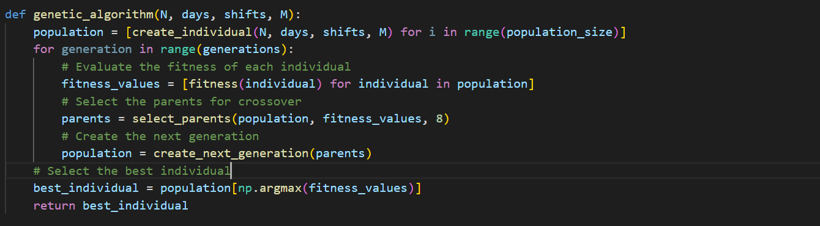
To create a class scheduling using genetic algorithm, then we have the following idea:
Step 2: From the population, we calculate fitness of each individual. After that, we use the select_parents function to choose the best individuals from the population to generate the next generation. We have two functions: mutation and crossover to ensure the diversity of the next generation. The genetic algorithm is represented like this:

Slide 19
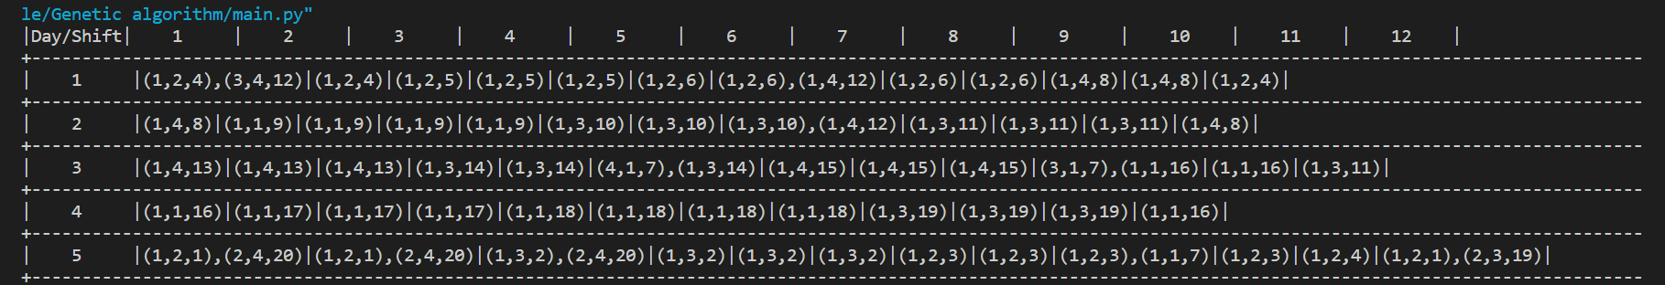
To create a class scheduling using genetic algorithm, then we have the following idea:
Step 3: Now the best schedule we get is the schedule return after the genetic function. However, after several crossover and mutation, the result doesn’t satisfy the constraint the constraint. Therefore, we have a refine function to make the schedule suitable.
Step 4: After refine, we get the final schedule and now we can print them for observation.
Here is an example of how the output prints :

Slide 20
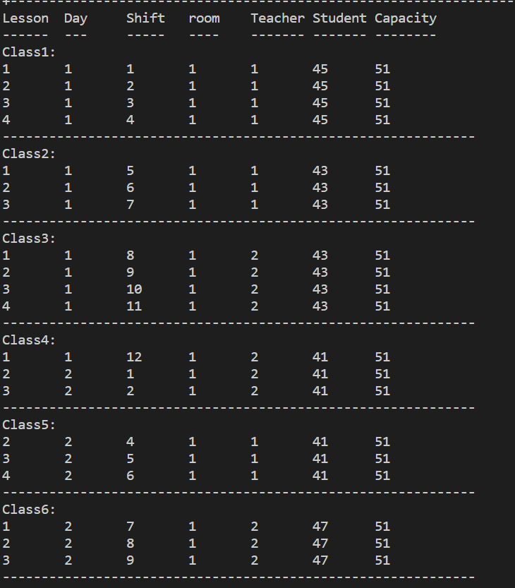
Another example: (print in 2 ways)

